Slide 1
‘The Tour’
Project Guide:-
Dr. Dhaval Joshi.
Internal Guide:-
Ms. Niti Tamakuwala
Submitted By:-
Harsh Patel.
YashpalSingh Rajpurohit.

Slide 2
COMPANY PROFILE
Company Name: | Department of ICT,VNSGU.
Guide Name: | Dr. Dhaval Joshi
Address: | J.P. Dawar Institute Of Information Science & Technology, Veer Narmad South Gujarat University,Udhna Magdalla Road, Surat, Gujarat
Contact No.: | 8488020249
Email: | Dhaval.joshi81@gmail.com

Slide 3
Project Profile
Project title : | ‘The Tour’
Name of Institute : | J.P. Dawer Institute OF Science And Technology , Veer Narmad South Gujarat University,Surat.
Front End Tool : | JavaScript, Bootstrap, ASP.NET MVC
Back End : | C#.NET, SQLServer
Operating System : | Window 10
Other Technology : | Entity Framework

Slide 4
Project Purpose:-
Book a complete holiday package .
Plan Holiday from home.
Book anytime
User-friendly design

Slide 5
Project Scope:-
Admin
Consumer

Slide 6
Admin:-
Login/Logout
Create and Delete Package
View Customer Details.
Add and Update Guide.
Add Hotel and its detail.

Slide 7
User:-
Register
Login/Logout
Search for available Package.
View Package Detail and select date.
Book Selected Package.

Slide 8
Project Objective:-
Quick & fast Search
Easy to view Package and its details.
Easy Booking.
Saves time, energy & money.
Quick & Efficient
Easy to use GUI

Slide 9
Advantages:-
Easy to plan trip by easily booking holiday package.
Can customize the package according to the users need.
Simple and easy User Interface for fast booking.
Saves time and energy.

Slide 10
Limitations:-
Only valid within the Nation.
This site is only in English.
There is no Travel option included in Package

Slide 11
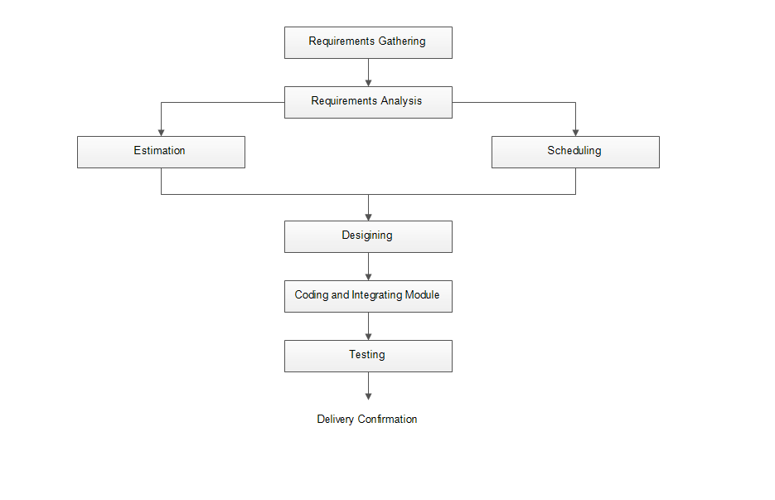
Task Dependency Chart

Slide 12
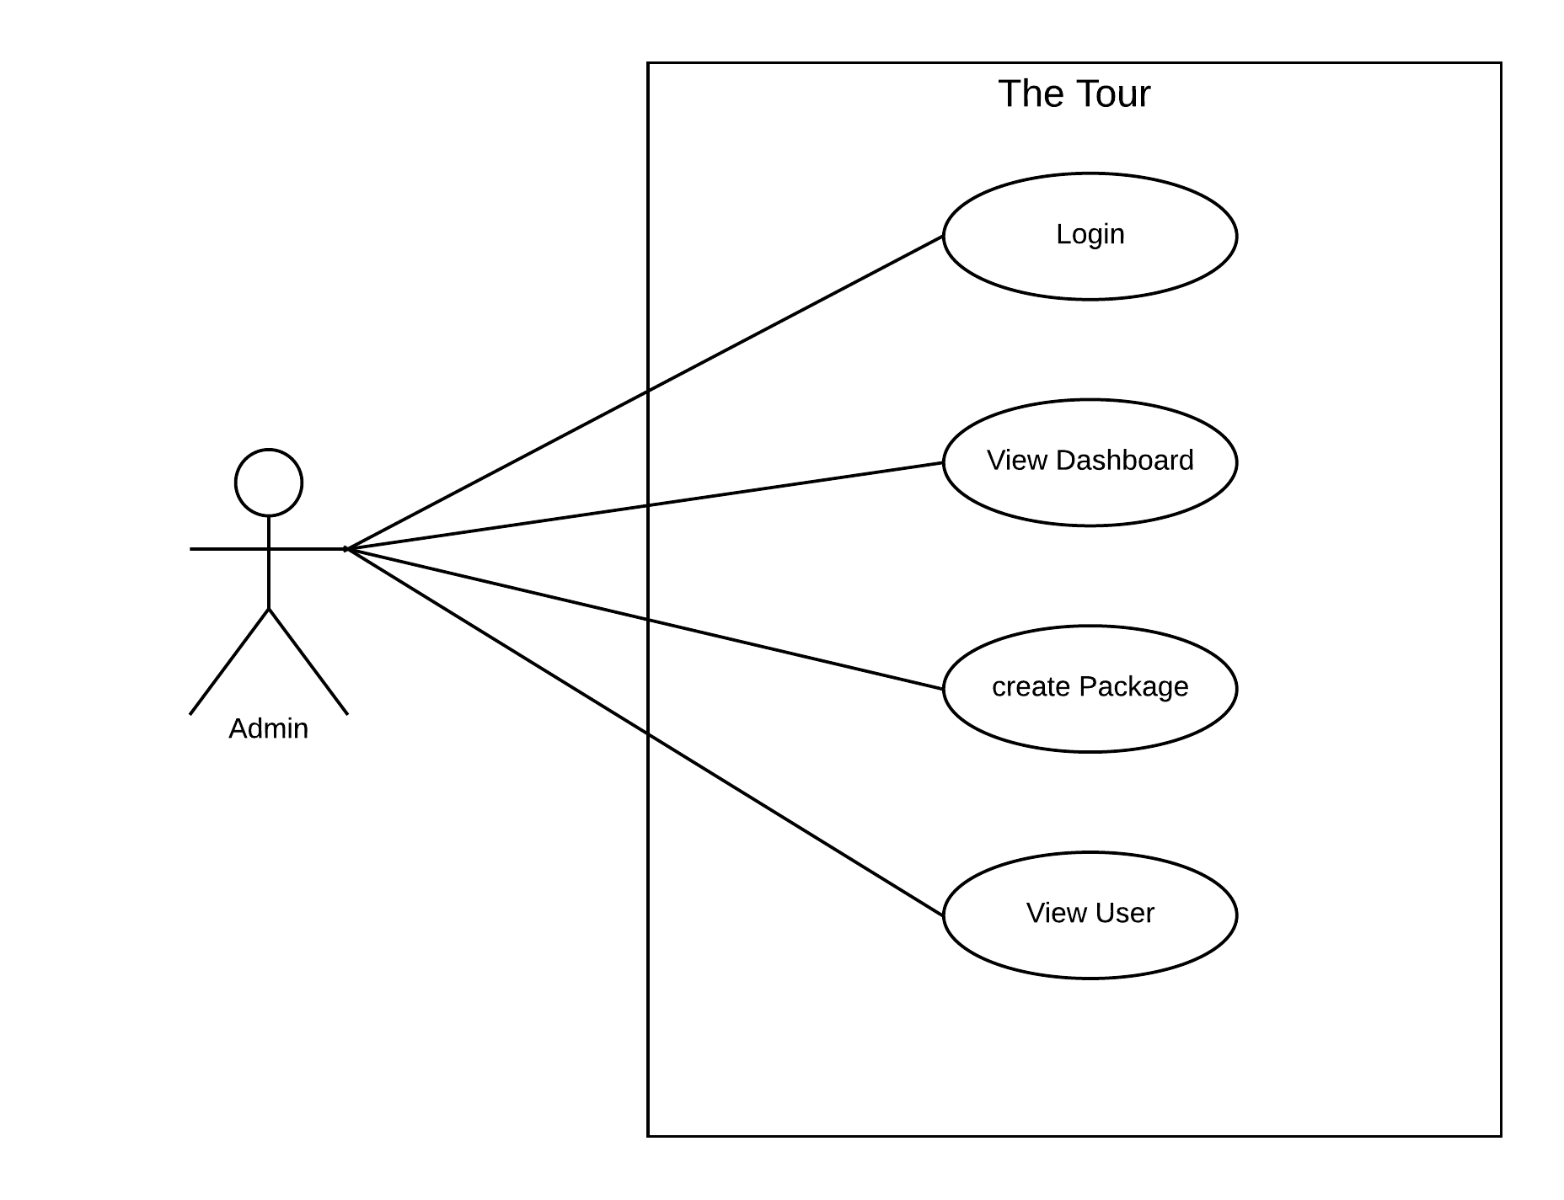
Use Case Diagram:- 1)Admin

Slide 13
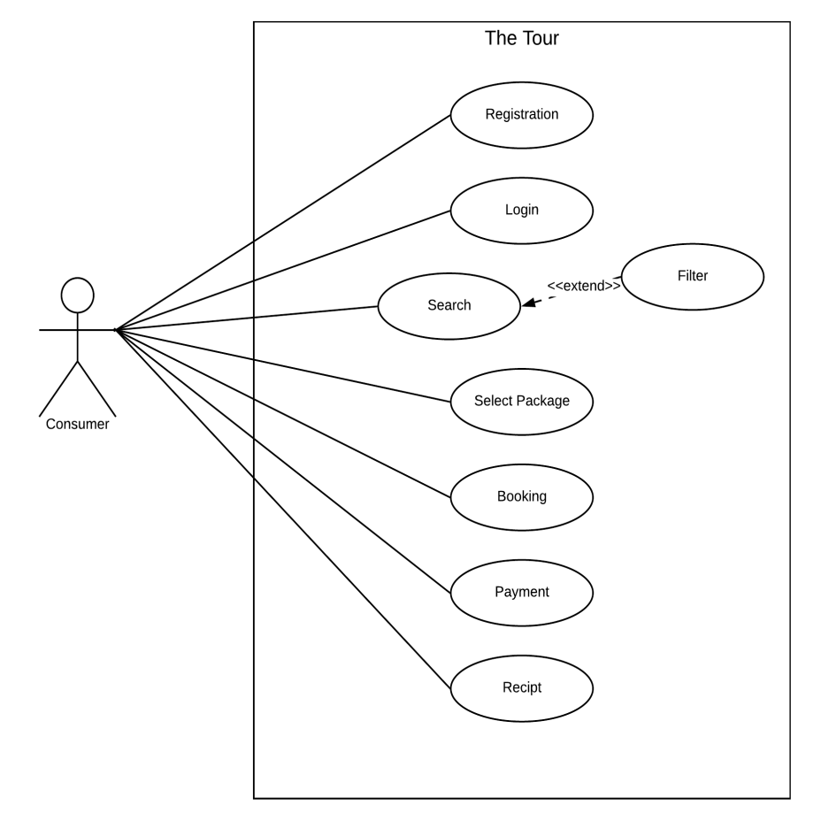
Use Case Diagram:- 2)Consumer

Slide 14
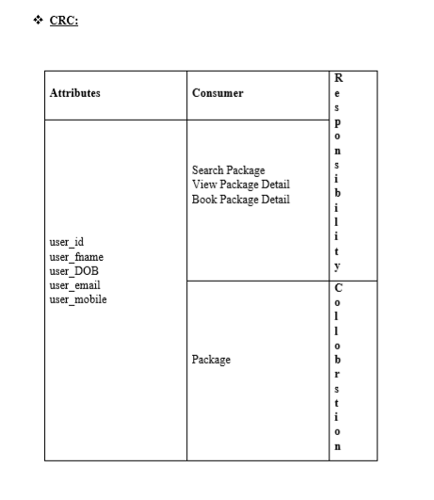
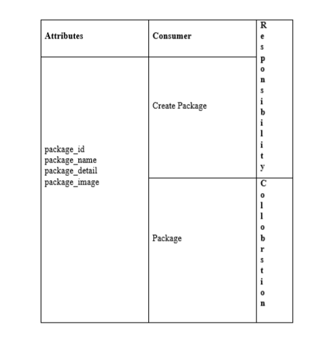
CRC

Slide 15
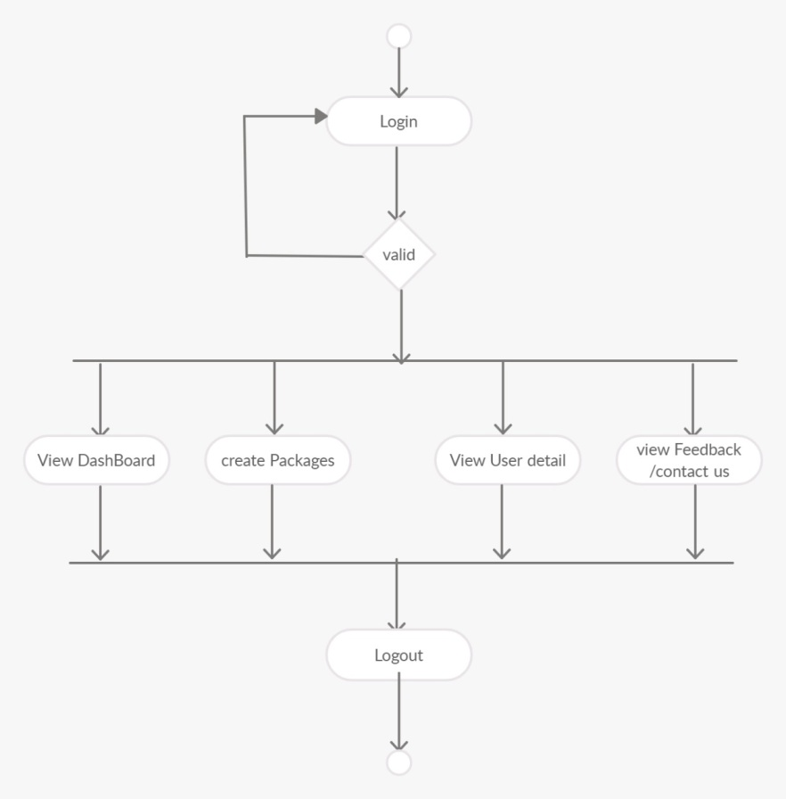
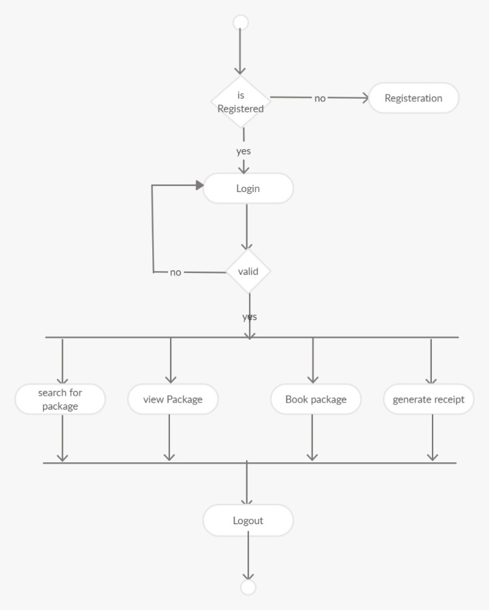
Activity Diagram

Slide 16
Database Design Activity Type Table:-
Sr.No. | Field Name | Datatype | Constraint
1 | activityType_id | Int | Primary Key
2 | activityType_name | varchar(25)
3 | createDate | Date
4 | updateDate | Date

Slide 17
Food Time Detail Table:-
Sr.No. | Field Name | Datatype | constraint
1 | foodTime_id | Int | Primary Key
2 | foodTime _name | varchar(20)
3 | createDate | Date
4 | updateDate | Date

Slide 18
State Table:-
Sr.No. | Field Name | datatype | constraint
1 | state_id | int | Primary Key
2 | state_name | varchar(20)
3 | createDate | Date
4 | updateDate | date

Slide 19
City Table:-
Sr.No. | Field Name | Datatype | constraint
1 | city_id | int | Primary Key
2 | city_name | varchar(30)
3 | state_id | int | Foreign Key
4 | createDate | date
5 | updateDate | date

Slide 20
Activity Table:-
Sr.No. | Field Name | Datatype | constraint
1 | activity_id | int | Primary Key
2 | activity_name | varchar(25)
3 | activity_timing | time(7)
4 | activity_cost | money
5 | activity_type | int | Foreign Key
6 | createDate | date
7 | updateDate | date

Slide 21
User Table:-
Sr.No. | Field Name | Datatype | constraint
1 | user_id | int | Primary Key
2 | user_fname | varchar(25)
3 | user_lname | varchar(25)
4 | user_DOB | date
5 | user_gender | char(1)
6 | user_city_id | int | Foreign Key
7 | user_password | varchar(25)
8 | user_mobile | varchar(10)
9 | user_email | varchar(30)
10 | userType | int
10 | createDate | datetime
11 | updateDate | datetime

Slide 22
Hotel Table:-
Sr.No. | Field Name | Datatype | constraint
1 | hotel _id | int | Primary Key
2 | hotel_name | varchar(50)
3 | city_id | int | Foreign Key
4 | foodTime_id | int | Foreign Key
5 | hotel_Cost | money
6 | createDate | date
7 | updateDate | date

Slide 23
Guide Table:-
Sr.No. | Field Name | Datatype | constraint
1 | guide_id | int | Primary Key
2 | guide_name | varchar(50)
3 | guide_gender | char(1)
4 | guide_city_id | int | Foreign Key
5 | guide_contact | varchar(10)
6 | guide_fees | money
7 | guide_status | bit
8 | createDate | date
9 | updateDate | Date

Slide 24
Package Table:-
Sr.No. | Field Name | Datatype | constraint
1 | package_id | int | Primary Key
2 | package_name | varchar(60)
3 | package_detail | varchar(100)
4 | package_image | text
5 | package_noOfDays | int
6 | package_noOfNights | int
7 | package_hotel_id | int
8 | package_guide_id | int
9 | package_city_id | int
10 | package_totalCost | money
11 | package_status | bit
12 | user_id | int
13 | createDate | datetime
14 | updateDate | datetime

Slide 25
User Package Table:-
Sr.No. | Field Name | Datatype | constraint
1 | userPackage _id | int | Primary Key
2 | user_id | int | Foreign Key
3 | package_id | int | Foreign Key
4 | Package_dateFrom | date
5 | Package_dateTo | date
6 | createDate | datetime
7 | updateDate | datetime

Slide 26
Package Activity Table:-
Sr.No. | Field Name | Datatype | constraint
1 | packageActivities_id | int | Primary Key
2 | package_id | int | Foreign Key
3 | activity_id | int | Foreign Key
4 | createDate | date
5 | updateDate | date

Slide 27
Payment Table:-
Sr.No. | Field Name | Datatype | constraint
1 | Payment_id | int | Primary Key
2 | payment_type | varchar(10)
3 | payment_amount | money
4 | payment_date | date
5 | user_id | int | Foreign Key
6 | payment_transaction_id | varchar(30)

Slide 28
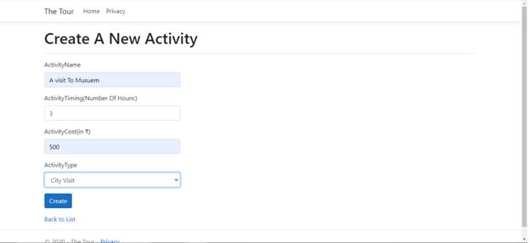
Interface Design Create Activity Page:-

Slide 29
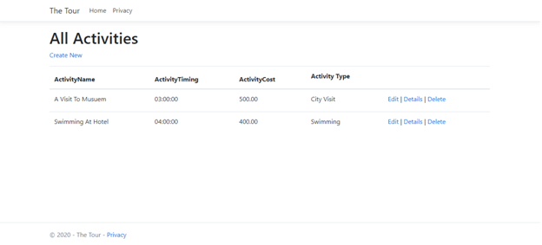
Display Activity Page:-

Slide 30
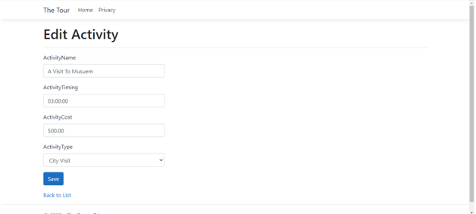
Edit Activity Page:-

Slide 31
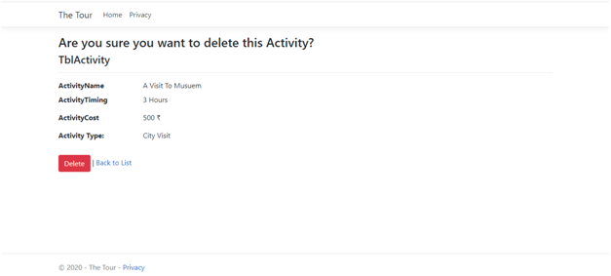
Delete Activity Page:-

Slide 32
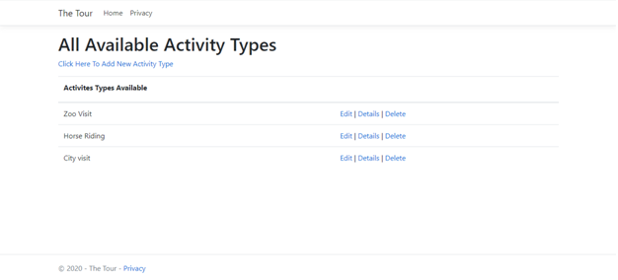
Display Activity Type:-

Slide 33
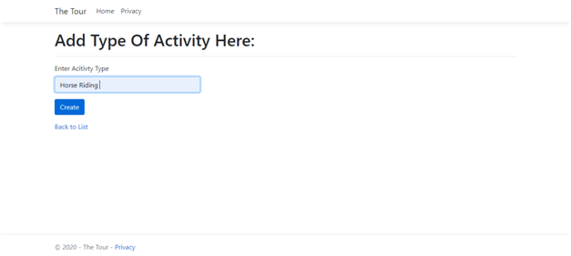
Insert Activity Page:-

Slide 34
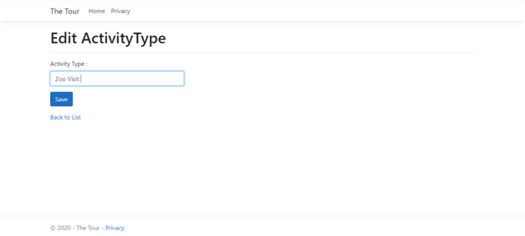
Edit Activity Type Page:-

Slide 35
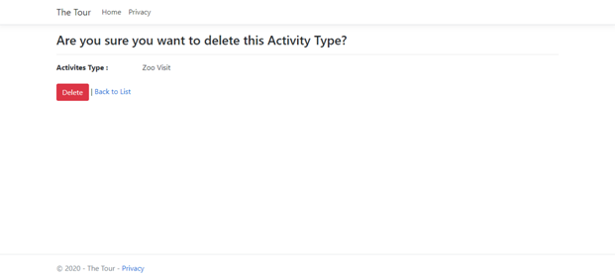
Delete Activity Type Page:-

Slide 36
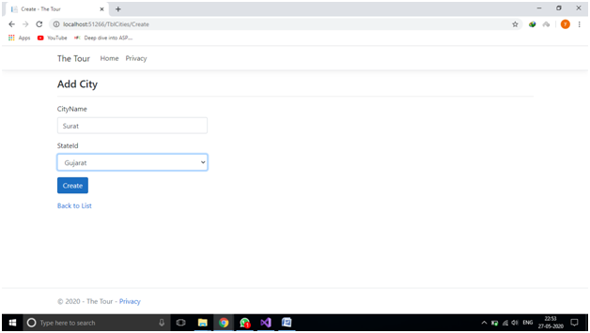
Insert City Page:-

Slide 37
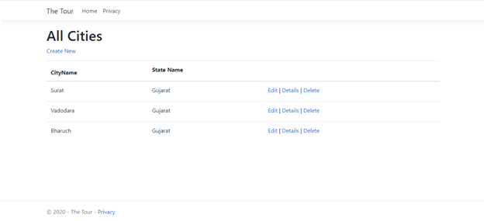
Display City Page:-

Slide 38
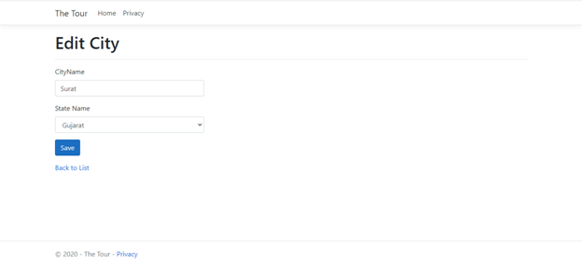
Edit City Page:-

Slide 39
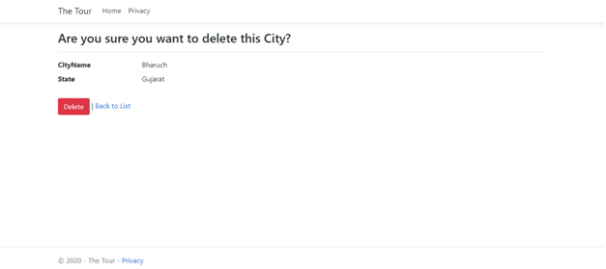
Delete City Page:-

Slide 40
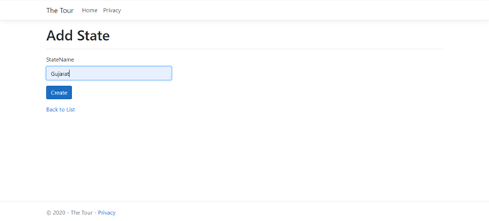
Insert State Page:-

Slide 41
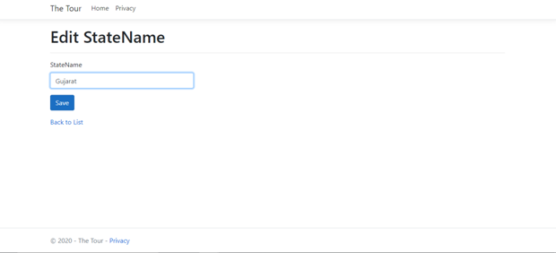
Edit State Page:-

Slide 42
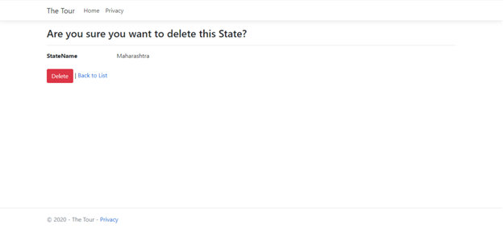
Delete State Page:-

Slide 43
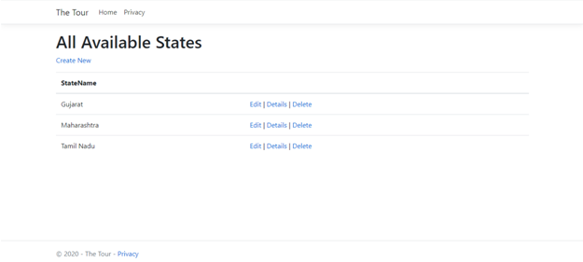
Display State Page:-

Slide 44
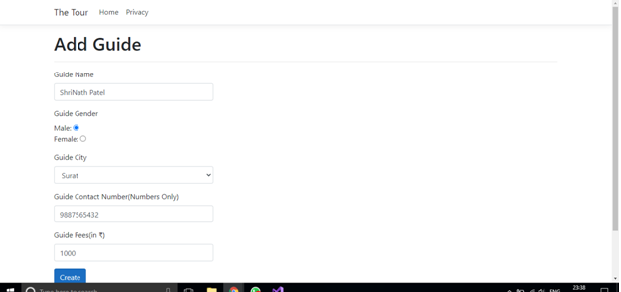
Insert Guide Page:-

Slide 45
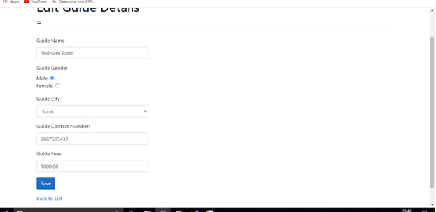
Edit Guide Page:-

Slide 46
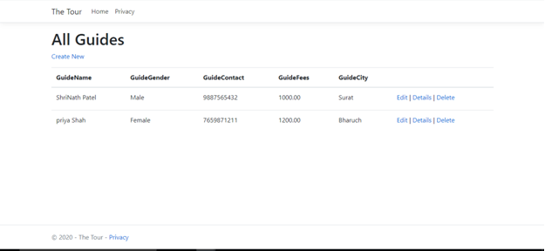
Display Guide Page:-

Slide 47
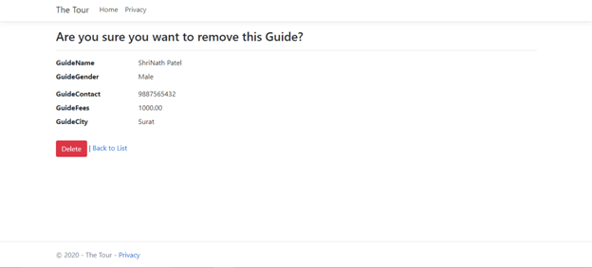
Delete Guide Page:-

Slide 48
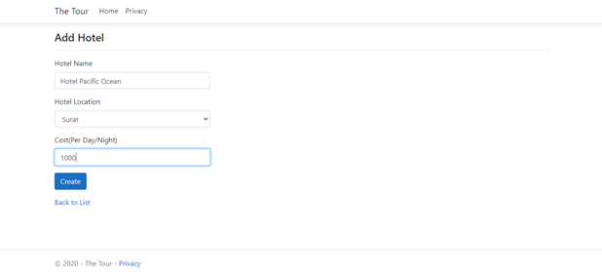
Insert Hotel Page:-

Slide 49
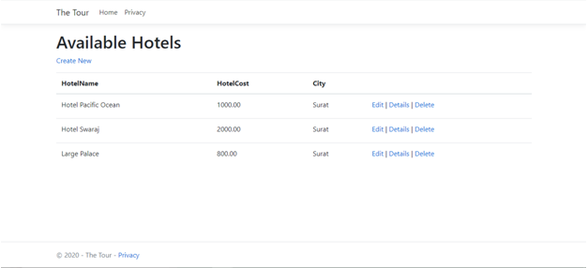
Display Hotel Page:-

Slide 50
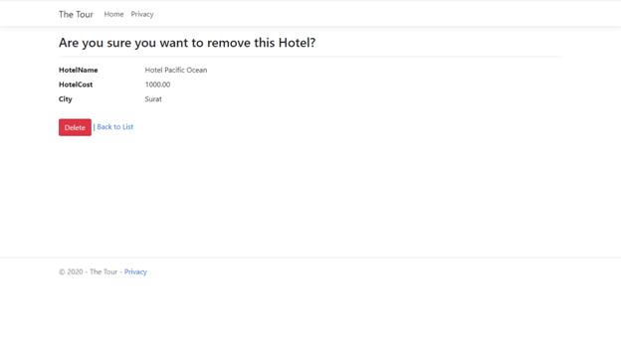
Delete Hotel Page:-

Slide 51
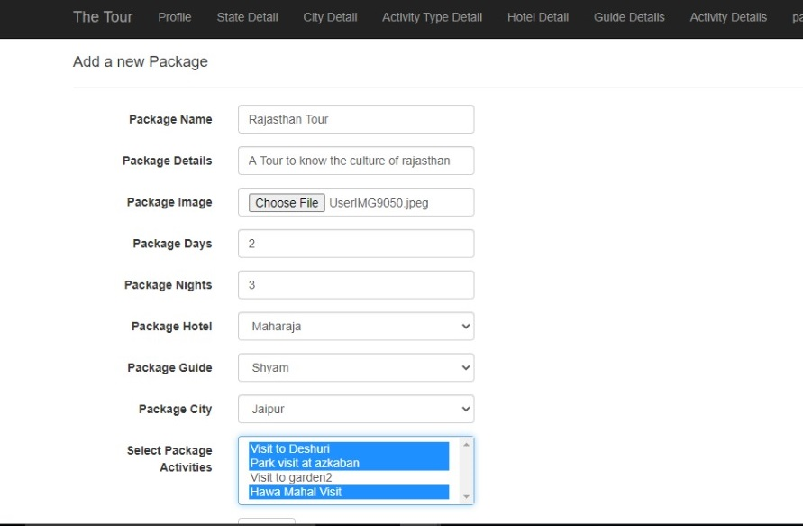
Package Insert Page:-

Slide 52
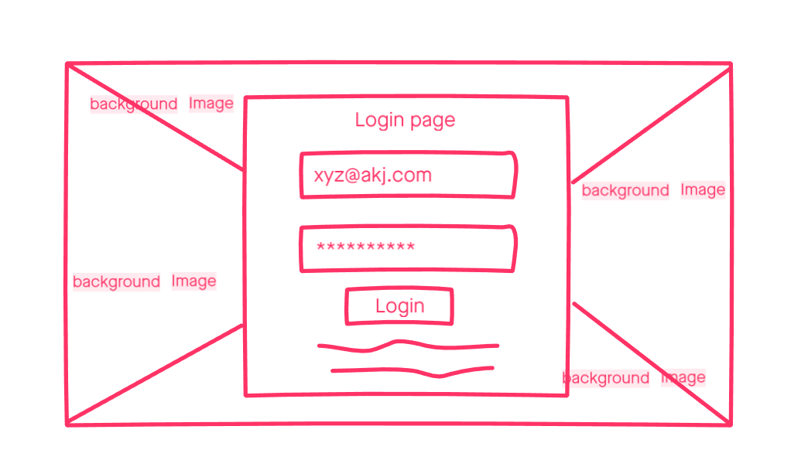
WireFrames Design For UI

Slide 53
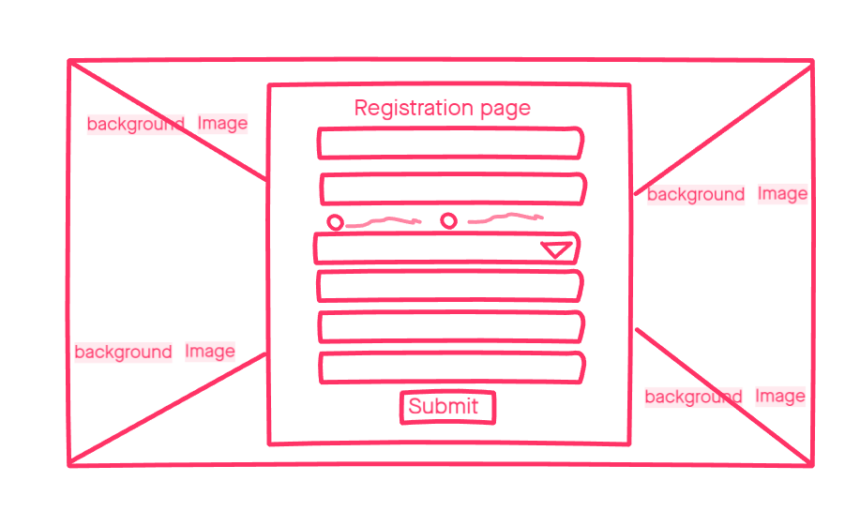

Slide 54
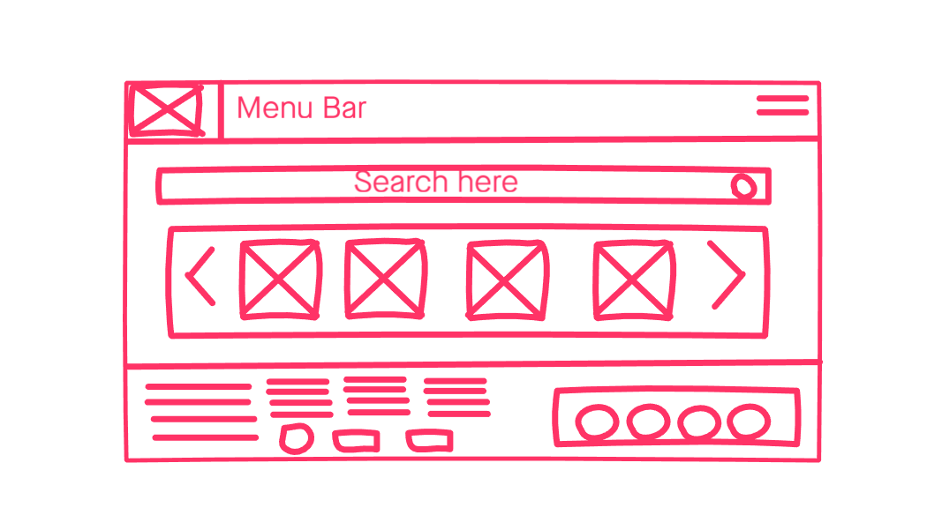

Slide 55
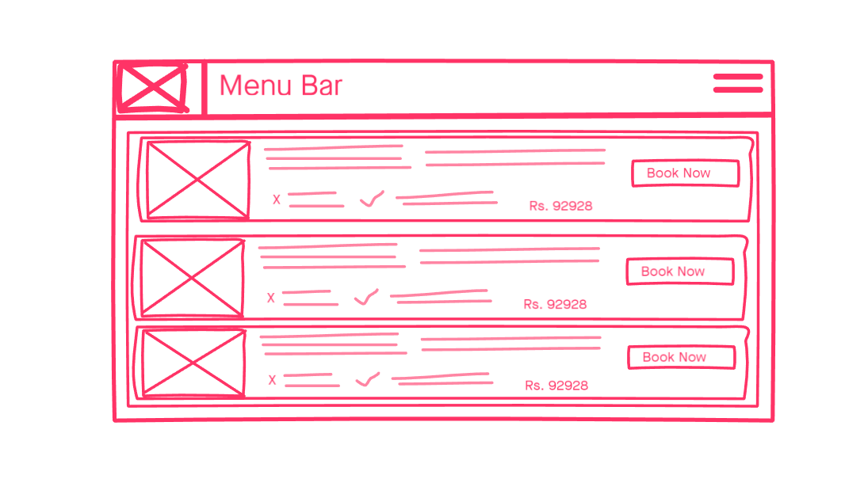

Slide 56
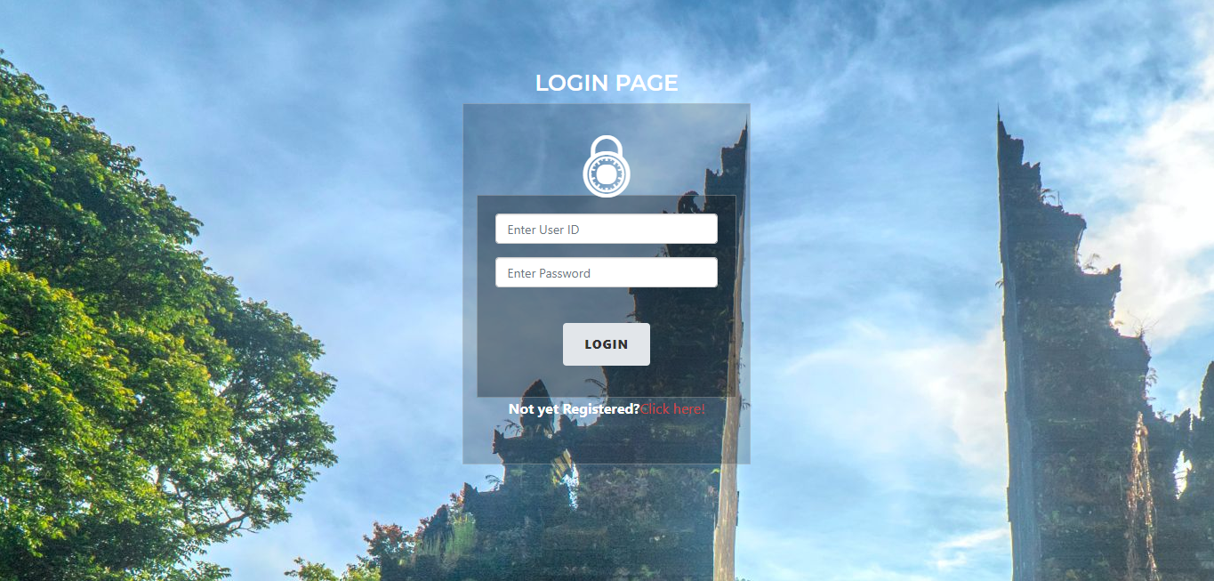
Consumer Layout Login Page

Slide 57
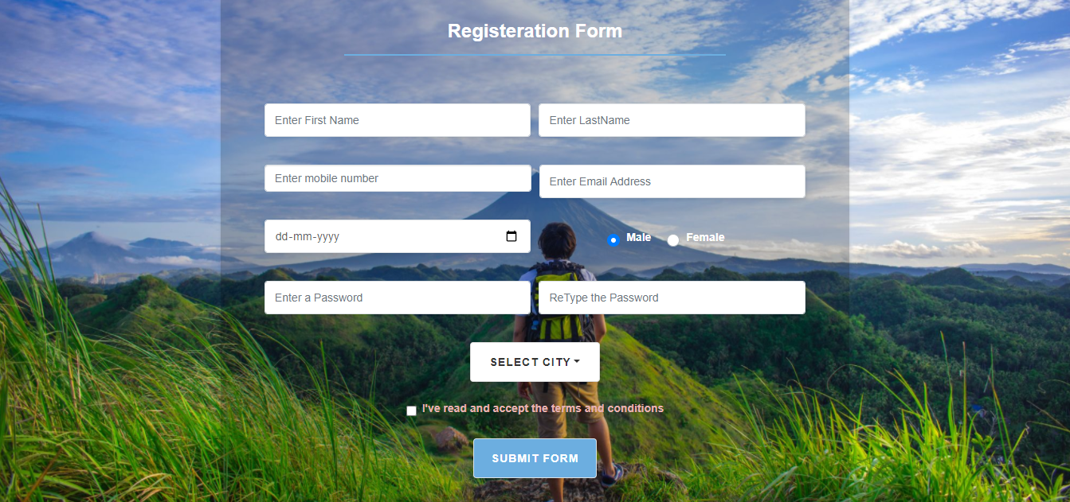
Registration Page

Slide 58
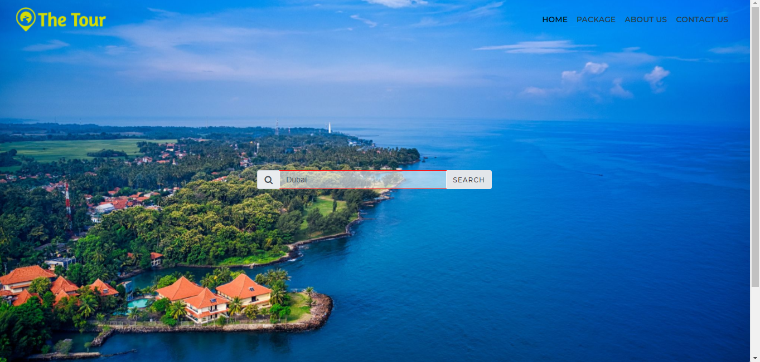
Home Page

Slide 59
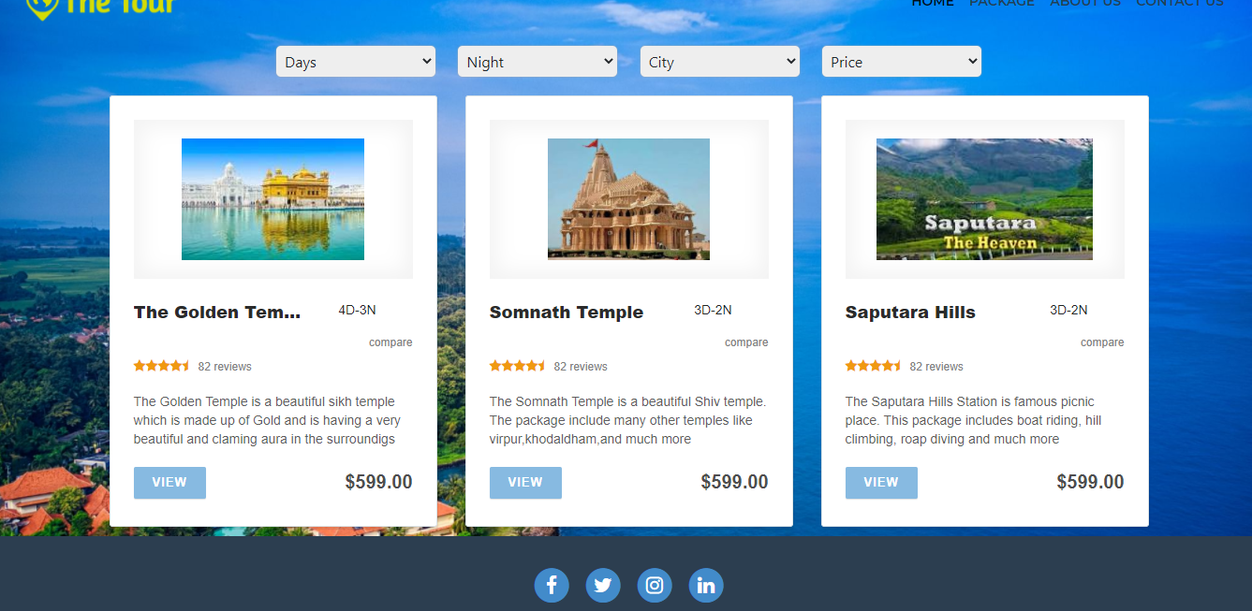
Package List Page

Slide 60
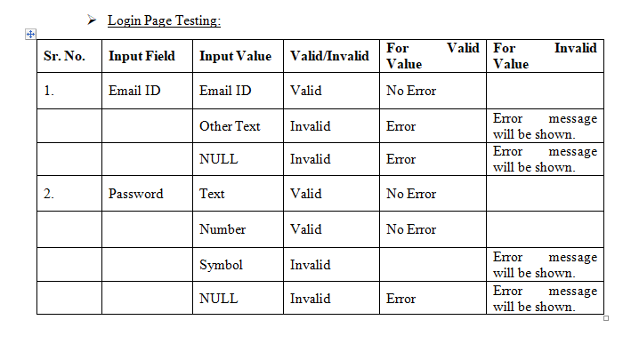
Test Cases

Slide 61
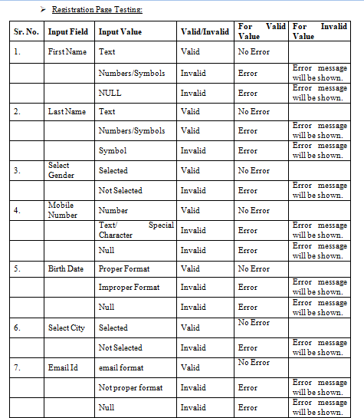
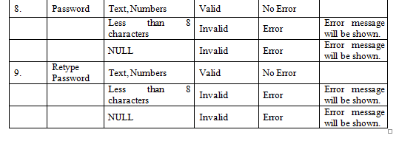

Slide 62
Future Enhancement:-
International Trip Package
Inclusion of Travel option in Package
Expansion of Customizing Package
Pick Up and Drop Service

Slide 63
Thank You!
PowerPoint Presentation By:-
-YashpalSingh G. Rajpurohit
-Harsh C. Patel.

